Slide 1

Tailored Marketing Strategies for Identified Customer Segments Using RFM
Team Turquoise

Slide 2
Executive Summary:
Reward our Champions: Top priority for retention, at 8.6% of total revenue. Offer discounts and exclusive referral programs to promote brand.
Encourage the Promising: Second highest average order value of £50.8. Optimize customer journey to create brand awareness and improve number of purchases (e.g., free trials).
Re-engage those Needing Attention: Known to be high performing, targeted email campaign will generate estimated £10,980. With limited time win-back promotions.

Slide 3
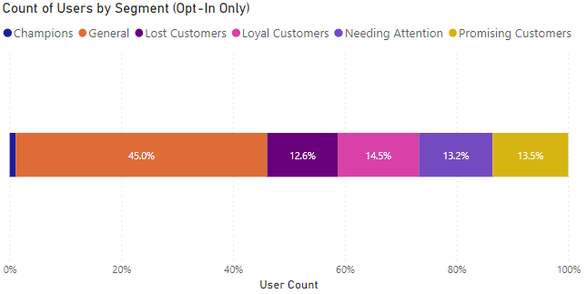
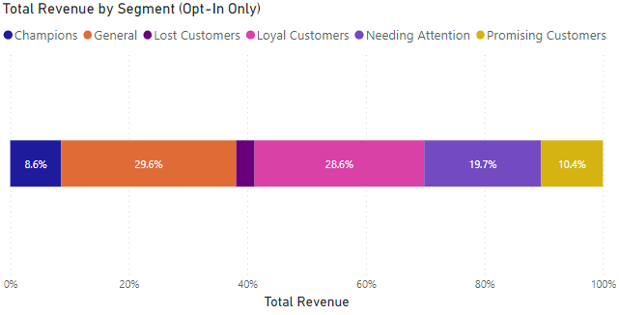
Reward our Champions.
Champions: those who bought most recently, often and spent the most. (RFM of 1-1-1)
Champions consist of 1.1% of the total customer base with email opt-ins.
However, champions generate a disproportionate percentage of overall email opt-in revenue. (8.6%)
Reward with discounts and VIP perks to build brand loyalty and advocacy.
Offer exclusive referral programs.
Creates powerful brand advocates, driving positive word-of-mouth and attracting customers. WOM marketing 5x more effective than paid ads. (Source)

Slide 4
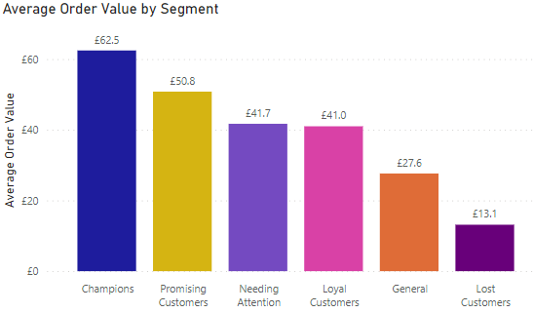
Encourage the Promising.
Promising Customers: those who have recently purchased but haven’t ordered often.
Promising consists of 13% of total opted in registered users.
Second highest average order value of £50.8, behind only champions, gives high potential for revenue.
Customer Journey Optimisation
Personalized product recommendations
Streamlining purchase process
Offer free trials (Prism Plus/Free Shipping).
Increasing repeat purchases from ‘Promising’ customers will generate greater revenue and grows our loyal customer base.

Slide 5
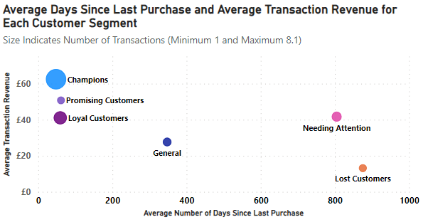
Re-engage those Needing Attention.
Needing Attention: those who haven’t purchased in a long time but spent well.
Bringing back known high performing customers will improve conversion rate and average order values.
Targeted offers to re-activate customer engagement:
Win-back promotions – “We miss you” emails.
Limited time offers.
Relevant content based on past purchases.
With companywide 2022 email conversion rates of 5%, and from this segment 5267 opted in to emails with an average order value of £41.7.
We expect a targeted email campaign to generate £10,980.

Slide 6
Conclusion
Reward our Champions:
Discounts and exclusive referral scheme.
Encourage the Promising:
Customer journey optimisation
Re-engage those Needing Attention:
Win back promotions with limited time offers.

Slide 7
Any Questions?
Thank you for listening!

Slide 8
How the segments are divided:
Segment | Characteristics | Strategy | Scores
Champions | Bought recently, often, and spent the most. | Reward them, build brand loyalty, and advocacy. Set up exclusive referral program. | 111
Loyal Customers | Spend good money with us often. | Engage them. Upsell higher value products. Ask for reviews and feedback. | 112,113,114,121,122,123,124,131,132,133.
Promising Customers | Recent shoppers but haven’t ordered often. | Create brand awareness. Offer free trials for prism plus/free shipping. | 134,141,142,143,144.
Needing Attention | Haven’t purchased in a long time but spend well. | Reactivate them. Make limited time offers. Offer relevant content based on past purchases. "We miss you" emails. | 211,212,221,222,311,312,411,412,413, 414,421,422,423,424,431,432,441,442.
General | Average in all. | Generalised marketing emails. | All others: 213,214,223,224,231,232,233, 234,241,242,243,244,313,314,321,322, 323,324,331,332,333,334,341,342, 343,344.
Lost | Lowest recency, frequency, and monetary scores. | Attempt to revive with reach out campaign. Ignore otherwise. | 433,434,443,444.
Score | 4 | 3 | 2 | 1
Recency | 100th percentile | 75th percentile | 50th percentile | 25th percentile
Frequency | 1 purchase | 2 purchases | 3-4 purchases | 5+ purchases
Monetary | 100th percentile | 75th percentile | 50th percentile | 25th percentile

Slide 9
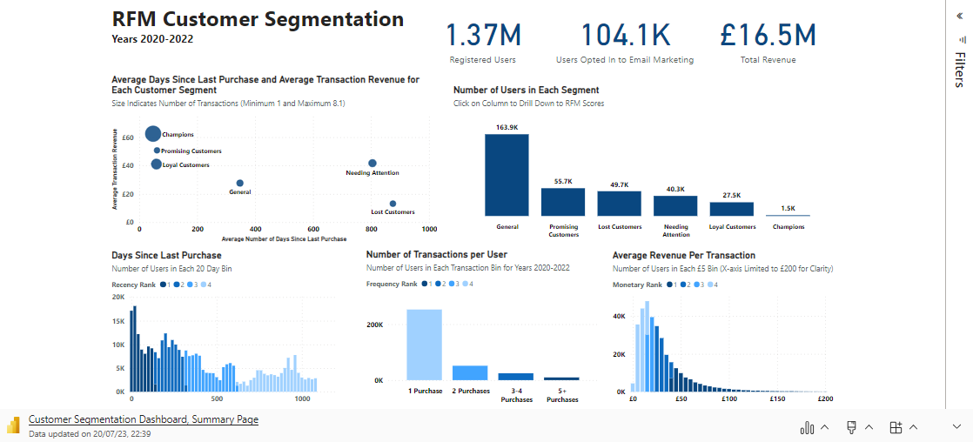
https://app.powerbi.com/links/_00KnMmlsQ?ctid=15830474-cef0-4326-88db-96e5ab019d8a&pbi_source=linkShare

Slide 10
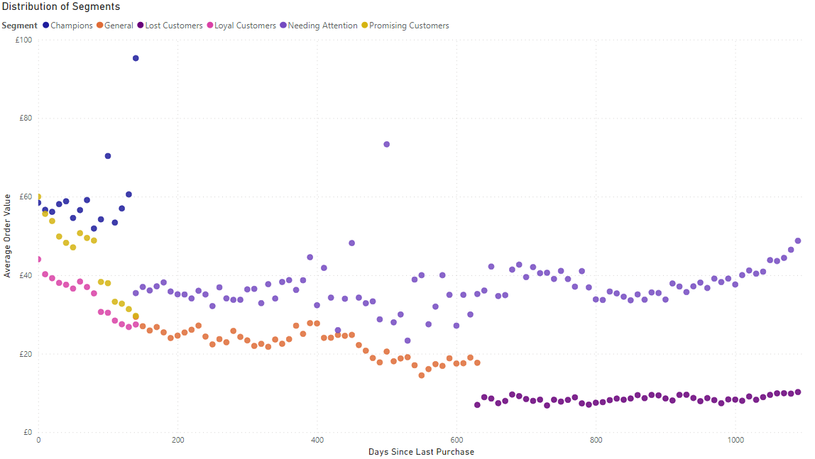
An overview of our segments:

Slide 11
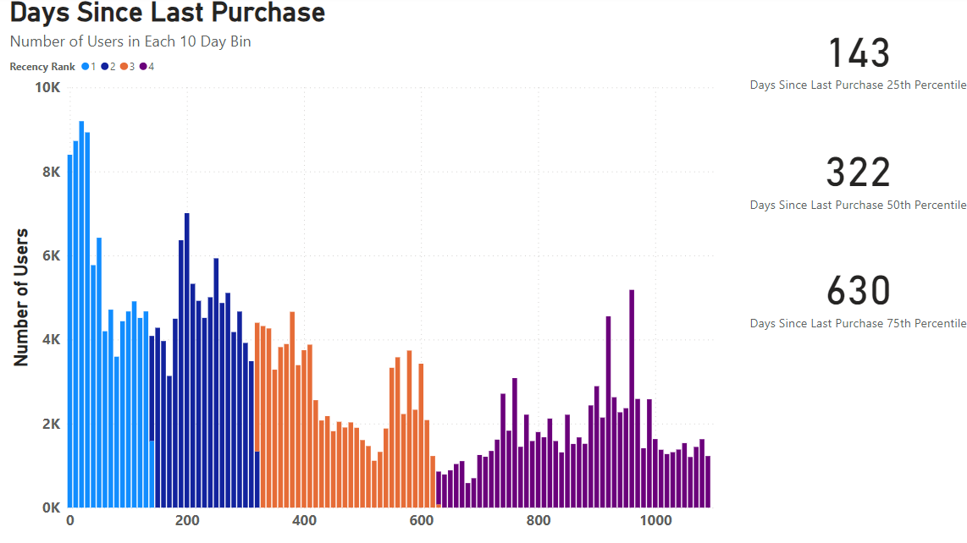
Recency Score

Slide 12
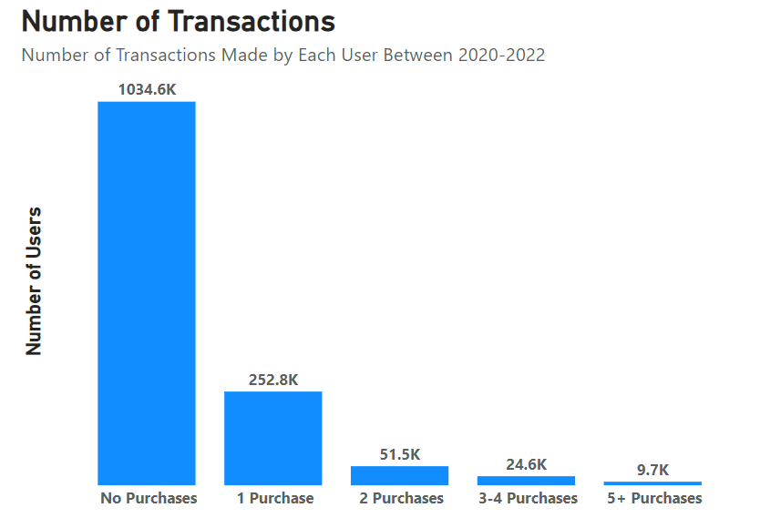
Frequency Score

Slide 13
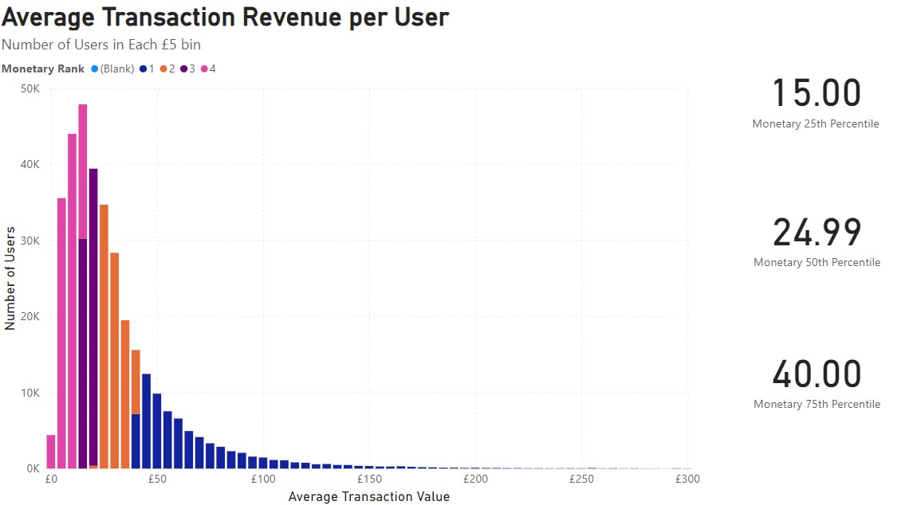
Monetary Score
X-axis limited to £300 for visual clarity. Full dataset available in dashboard.

